Slide 1
CLOCK 8051
Tuan Vo - Phuong Nho - Tip Phi

Slide 2
Contents
1
Introduction
2
Circuit
3
Program
4
Result

Slide 3
Diagram
Clock
Circuit
Built by team’s design and constructed completely handmade
After demo, the circuit has been fixed tobe suitable for long period of using time.
Code
Program started with simple idea that count up the second.
Update minute and hour.
Update setting mode.

Slide 4
Circuit
Led 7 Segment
Module Power
Stable
4 conn-cils.
Use pot-res to adjust.
Supply stable 5V power from adapter or battery sources.
Setting Button
(using Pull-up res)
Hour
Minute
Second
Start
Stop
Reset
MCU
MCU
Text
74LS47 for decoding

Slide 5
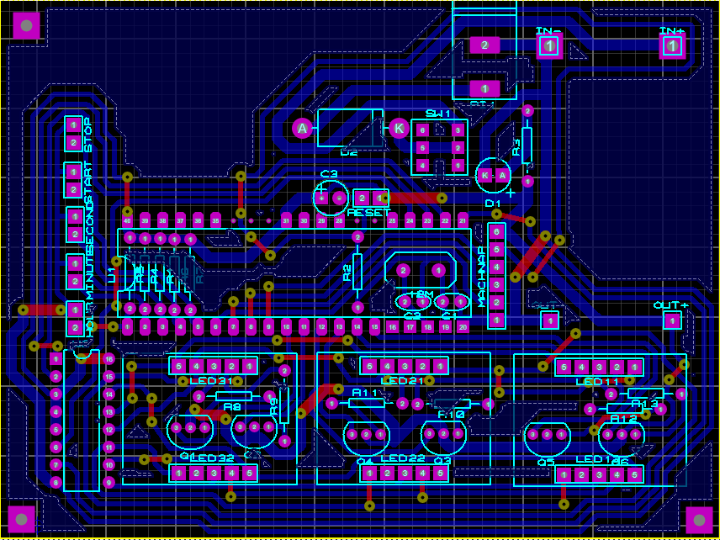
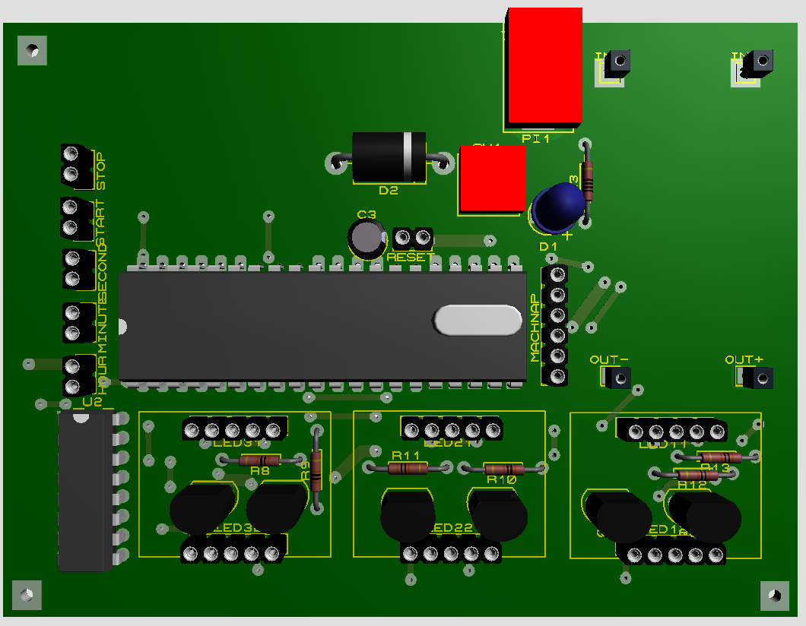
Schematic and 3D Layout
Setting Button
Power Supply and module LM2596
MCU and addition
74LS47
Led 7 Segment and addition

Slide 6
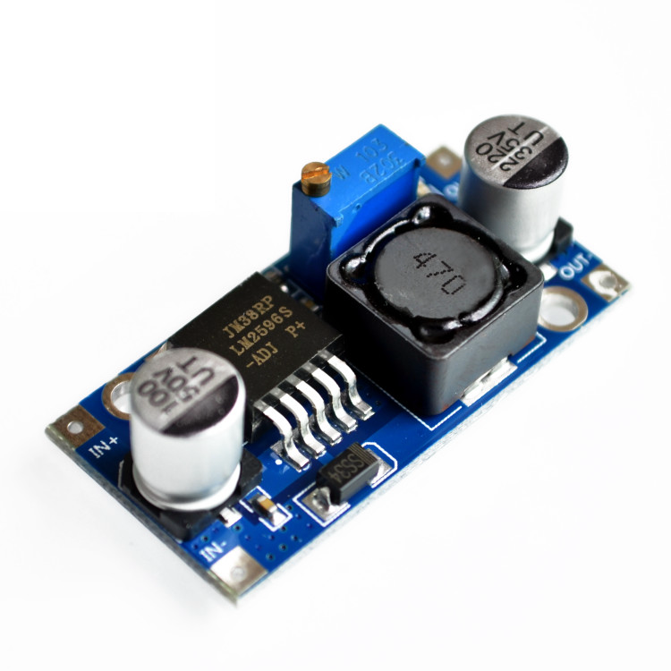
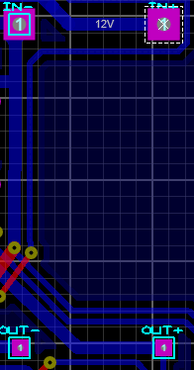
Module LM2596 3A DC-DC

Slide 7
Module LM2596 3A DC-DC
This module uses the LM2596 chip, with high efficiency (up to 92%) and small heat. It can bear up to 3A current if with heat sink, or bear less than 2.5A without heat sink.
Output voltage can be changed between 1.25V ~ 30V

Slide 8
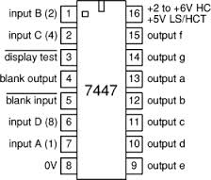
74LS47 (DECODING IC)
74LS47 pinout

Slide 9
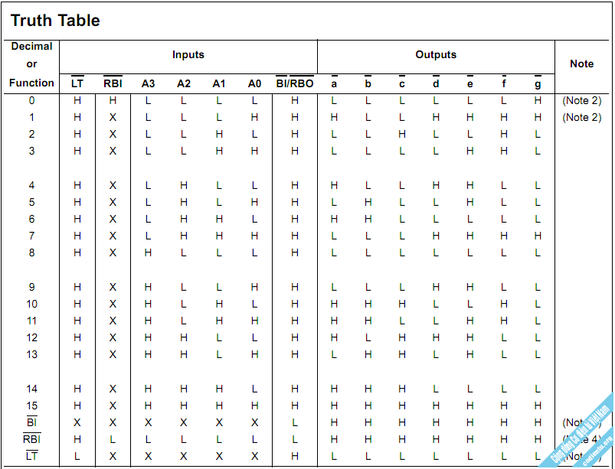
74LS47 (DECODING IC)
Using 5V volatage supply

Slide 10
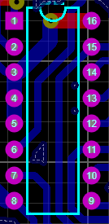
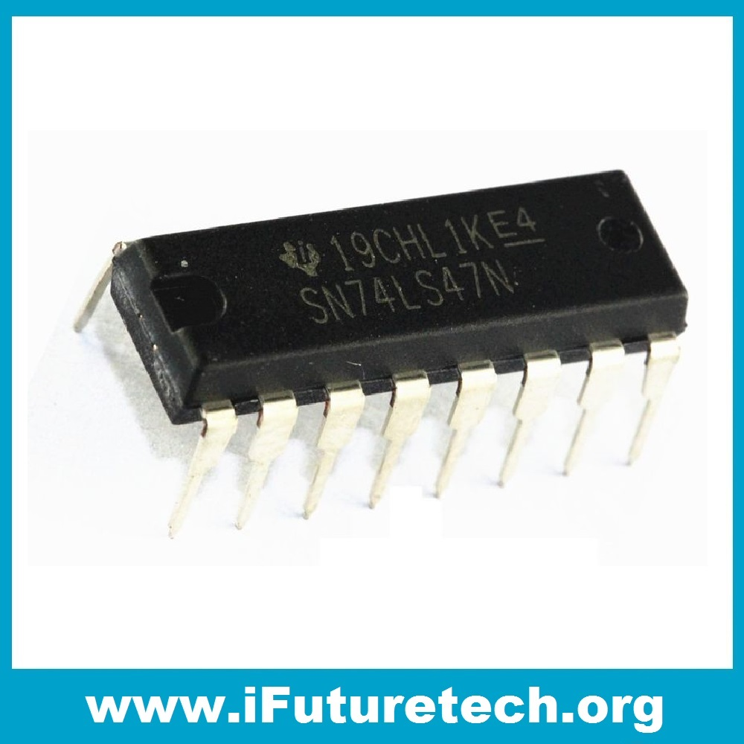
74LS47 (DECODING IC)

Slide 11
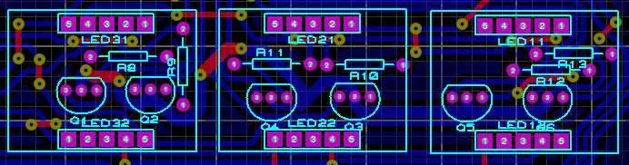
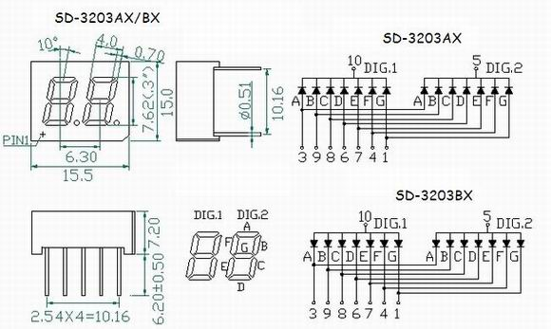
LED 7 SEGMENT AND ADDITION

Slide 12
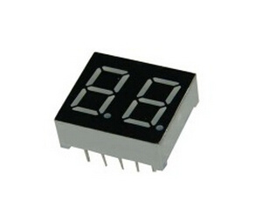
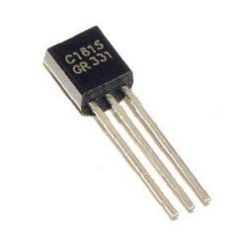
LED 7 SEGMENT AND ADDITION
Dual Led 7 Segment Common Anode
C1815

Slide 13
LED 7 SEGMENT AND ADDITION
Using C1815 to enlarge, amply the voltage for led 7 segment.
Led 7 function at stable mode is 5V.
Using resistor 330 ohm to reduce the voltage which is supplied from C1815, protect led 7 segment.

Slide 14

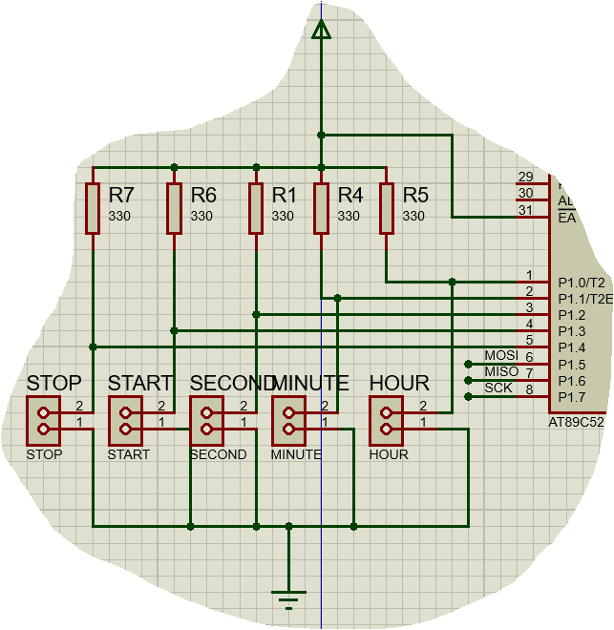
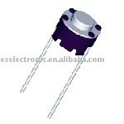
Button Setting

Slide 15
Button Setting
Using pull-up resistor method for time setting
Can be used flexibly during starting program or in the middle of it.
Button design makes it easy to use and familiar with user.

Slide 16
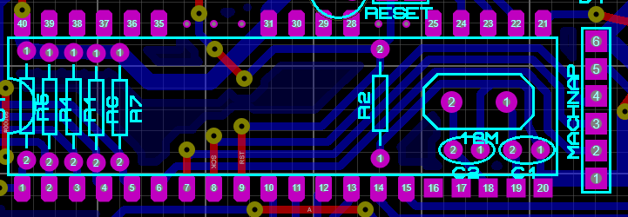
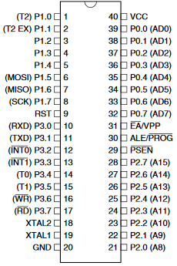
8051 MCU and addition
Using 12MHz Crystal.
Create one cycle clock equal 1us.
Easy to caculate.
Create a single line of conn-sil for USB-ISP to load Hex file.
Adding Reset Setting.
Using cap for filtering power supply.

Slide 17
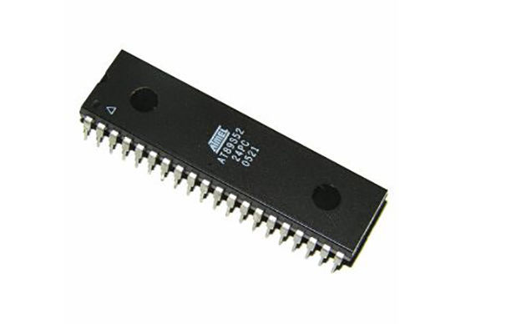
8051 MCU and addition
89S52

Slide 18
Cycle Code Diagram
Setting mode
Display
Led 7 Seg
Delay 1S
Divide
Time
Values
Clock
Increase
1S
Caculate
Time

Slide 19
Display led 7 segment
Using TIMER 0 to create delay for 6 led 7 segment.
Frequency is about 1ms per led.
1000us ~ 1ms

Slide 20
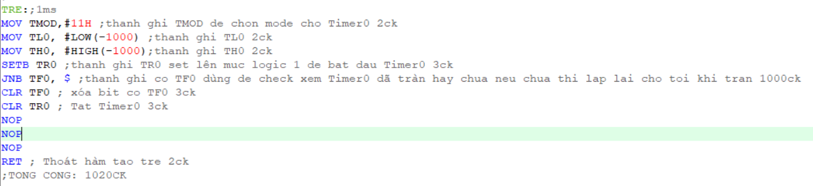
Display led 7 segment
Delay for led 7 segment

Slide 21
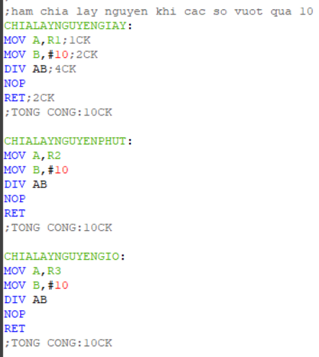
Display led 7 segment
Using devision code for number that greater than 10 cause 74LS47 ic can only decode from 0 to 9
Delay for led 7 segment

Slide 22
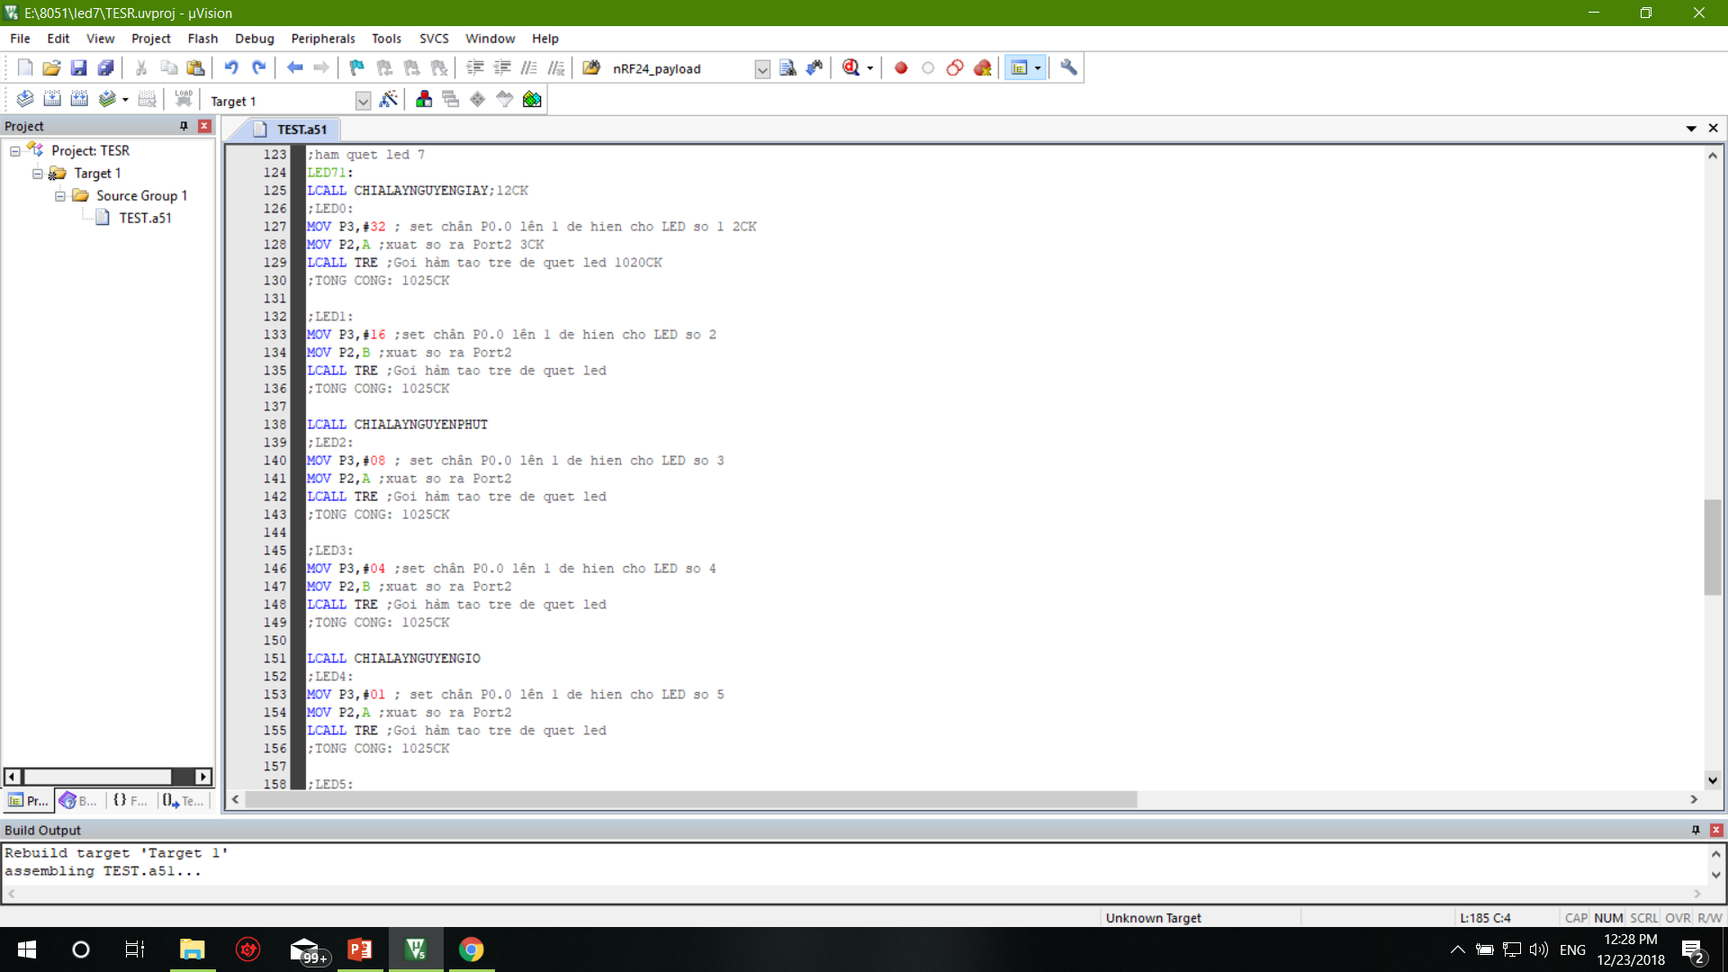
Display led 7 segment
Delay for led 7 segment

Slide 23
Delay 1S
Using TIMER 1 to create delay
While wating for TF1 flag about 3800 cycle, led 7 display is added to make sure the continuous program.
Time for Delay 1S is approximately 1 second, equal 998906 cycles = 998906 us

Slide 24
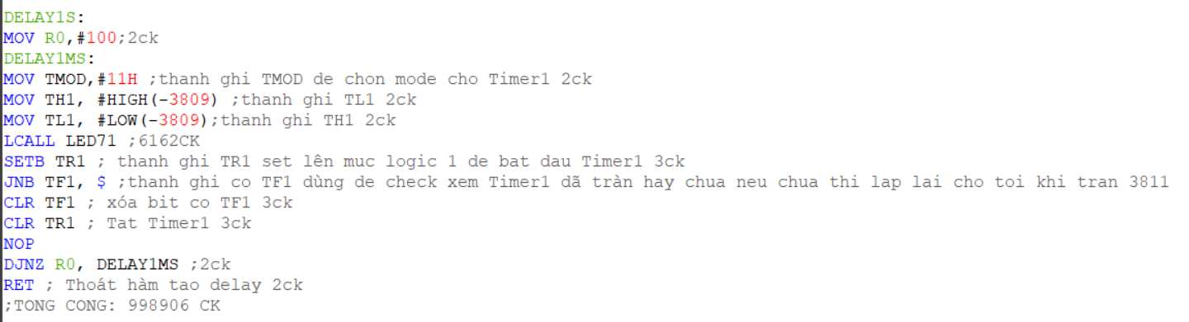
Display led 7 segment
Delay for led 7 segment

Slide 25
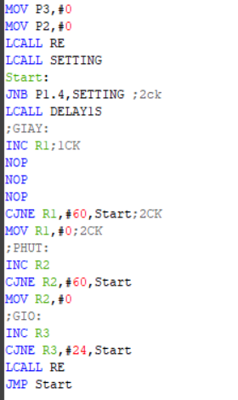
Caculate Time
After using TIMER 1 to create delay for 1 second, R0,R1,R2 take a role as a second, minute, hour and will be increase 1 unit like real time clock.

Slide 26
Setting Mode
This mode has 5 button:
Hour
Minute
Second
Start
Stop
Setting mode starts at the beginning of the program, or can be used while clock is ticking.
In this mode, time can only can be increase 1 unit per event of pushing button, 500ms for every event.

Slide 27
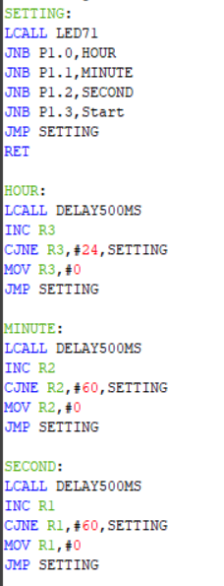
Setting Mode

Slide 28
Completed Program Diagram
CACULATE
DISPLAY LED 7
CLOCK
DELAY 1S
74LS47
DELAY FOR LED
SETTING MODE

Slide 29
Completed Product

Slide 30
Thank You !
http://blogcongdong.com

